Slide 1
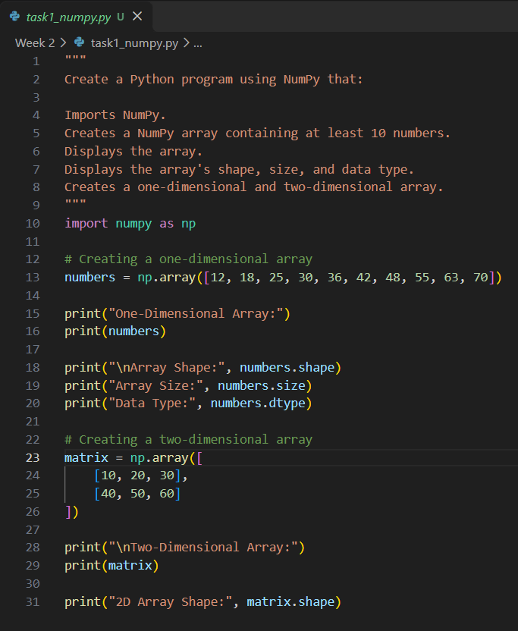
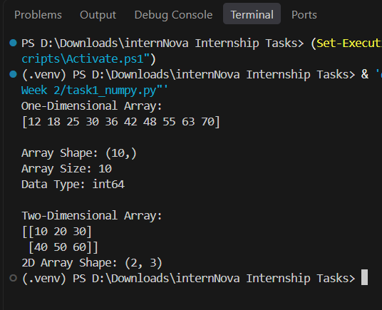
Task 1: NumPy Introduction & Arrays (10 Marks) Create a Python program using NumPy that: Imports NumPy. Creates a NumPy array containing at least 10 numbers. Displays the array. Displays the array's shape, size, and data type. Creates a one-dimensional and two-dimensional array.
Program
Output

Slide 2
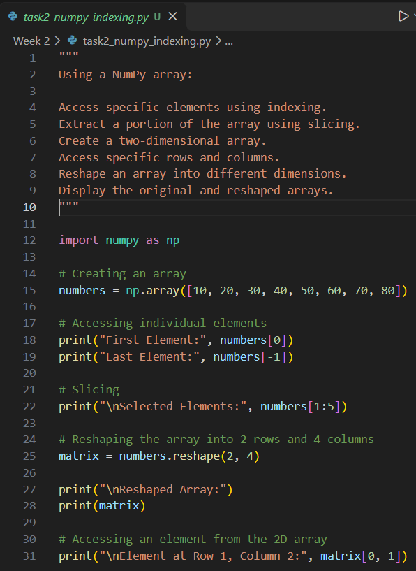
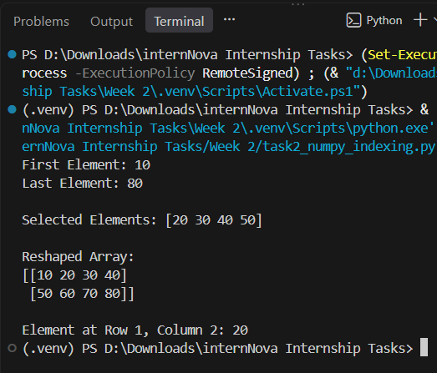
Task 2: NumPy Indexing, Slicing & Reshaping (10 Marks) Using a NumPy array: Access specific elements using indexing. Extract a portion of the array using slicing. Create a two-dimensional array. Access specific rows and columns. Reshape an array into different dimensions. Display the original and reshaped arrays.
Program
Output

Slide 3
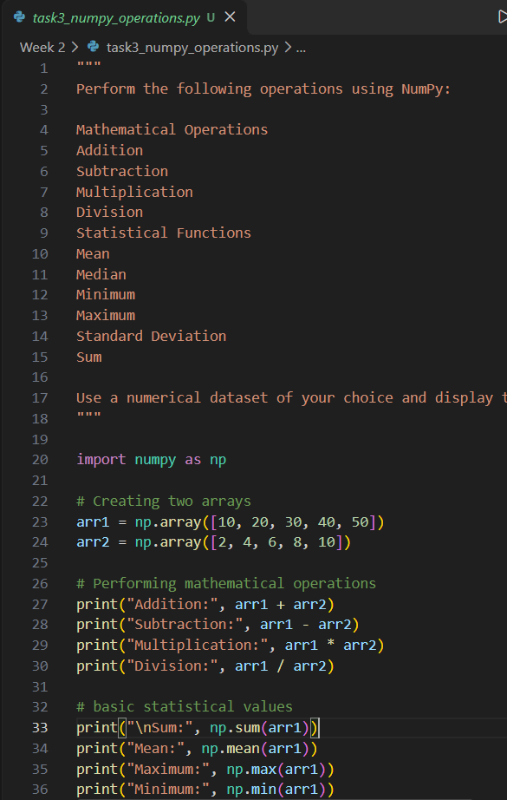
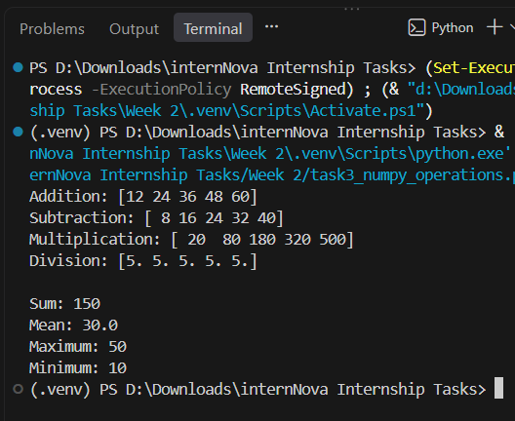
Task 3: NumPy Mathematical & Statistical Operations (10 Marks) Perform the following operations using NumPy: Mathematical Operations Addition Subtraction Multiplication Division Statistical Functions Mean Median Minimum Maximum Standard Deviation Sum Use a numerical dataset of your choice and display the results.
Program
Output

Slide 4
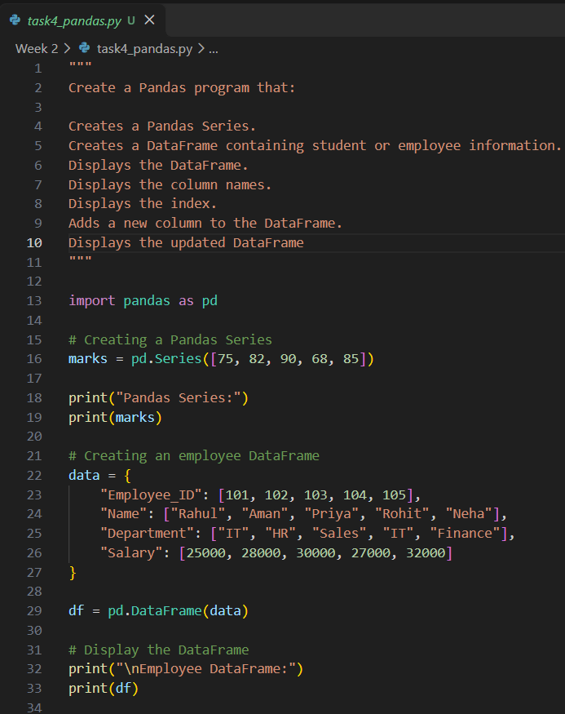
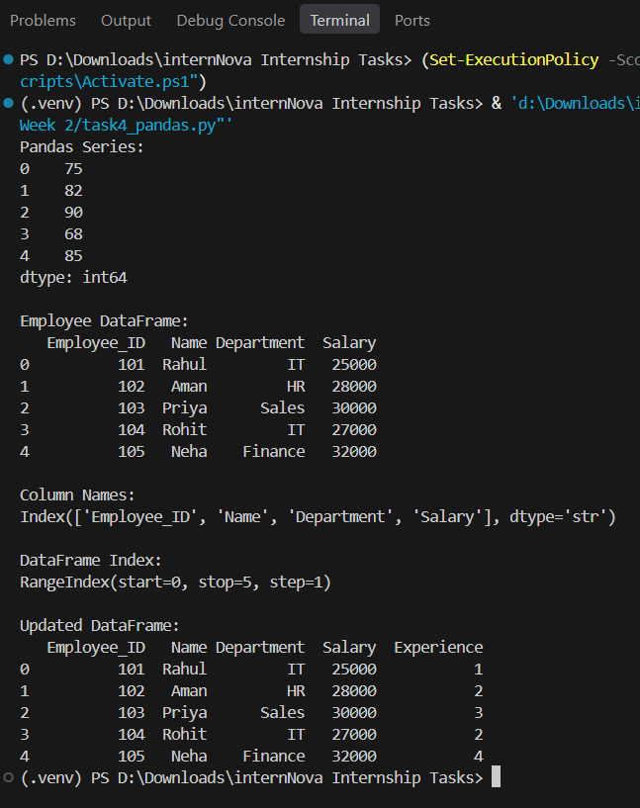
Task 4: Pandas Series & DataFrame (10 Marks) Create a Pandas program that: Creates a Pandas Series. Creates a DataFrame containing student or employee information. Displays the DataFrame. Displays the column names. Displays the index. Adds a new column to the DataFrame. Displays the updated DataFrame.
Program
Output

Slide 5
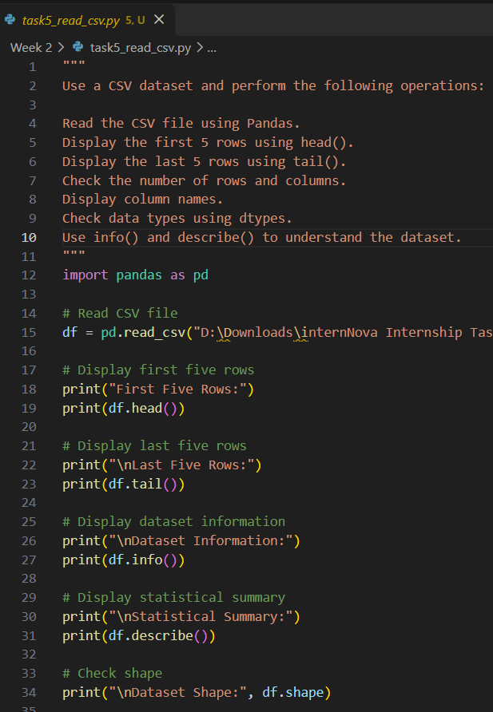
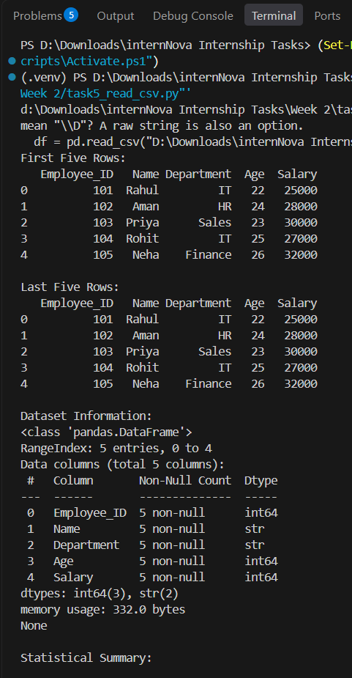
Task 5: Reading & Inspecting Data (10 Marks) Use a CSV dataset and perform the following operations: Read the CSV file using Pandas. Display the first 5 rows using head(). Display the last 5 rows using tail(). Check the number of rows and columns. Display column names. Check data types using dtypes. Use info() and describe() to understand the dataset.
Program
Output

Slide 6
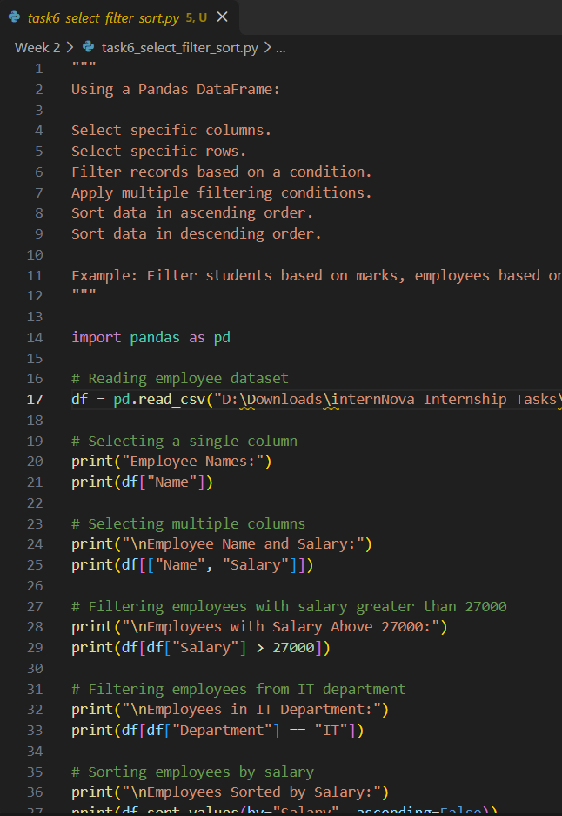
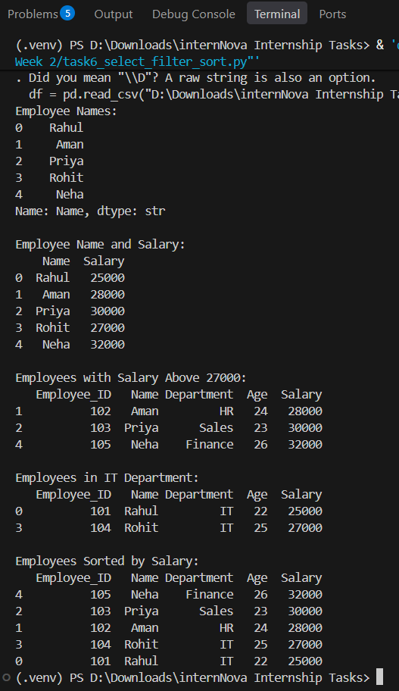
Task 6: Selecting, Filtering & Sorting Data (10 Marks) Using a Pandas DataFrame: Select specific columns. Select specific rows. Filter records based on a condition. Apply multiple filtering conditions. Sort data in ascending order. Sort data in descending order. Example: Filter students based on marks, employees based on salary, or products based on price.
Program
Output

Slide 7
Task 7: Handling Missing Values (10 Marks) Take a dataset containing missing values and perform the following: Identify missing values using isnull() / isna(). Count missing values in each column. Remove rows containing missing values. Fill missing values using appropriate methods. Display the dataset before and after handling missing values. Briefly explain why handling missing data is important in Data Analytics.
Program
Output

Slide 8
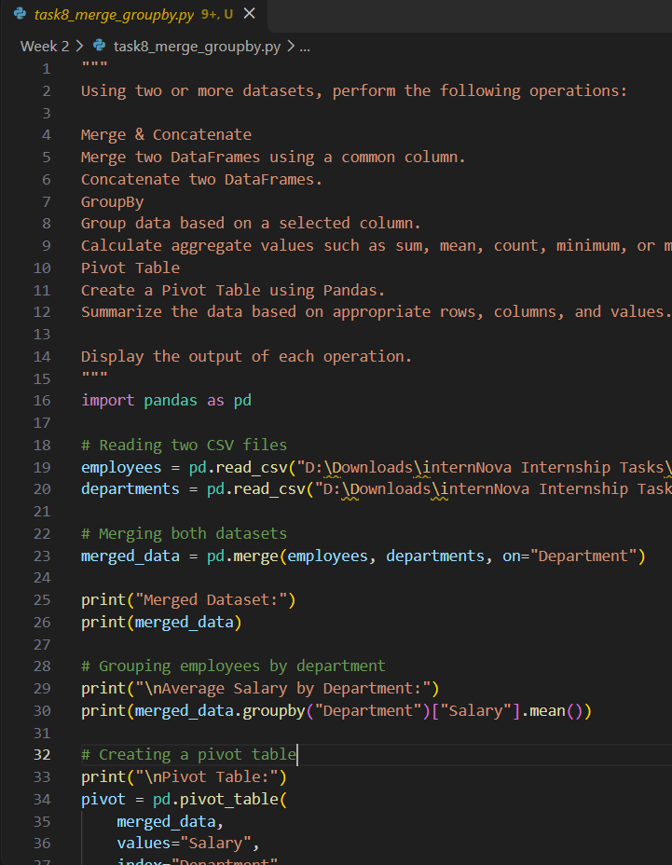
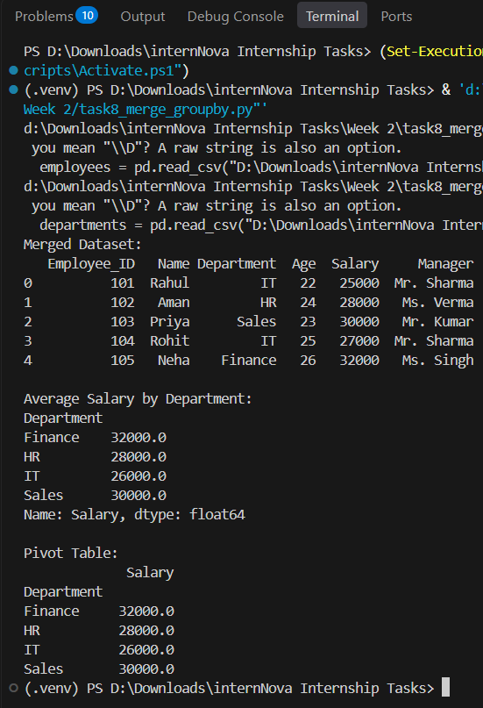
Task 8: Merge, Concatenate, GroupBy & Pivot Table (15 Marks) Using two or more datasets, perform the following operations: Merge & Concatenate Merge two DataFrames using a common column. Concatenate two DataFrames. GroupBy Group data based on a selected column. Calculate aggregate values such as sum, mean, count, minimum, or maximum. Pivot Table Create a Pivot Table using Pandas. Summarize the data based on appropriate rows, columns, and values. Display the output of each operation.
Program
Output

Slide 9
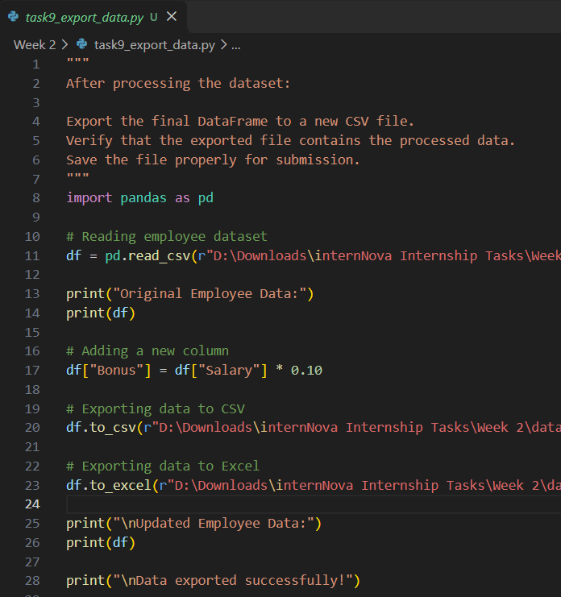
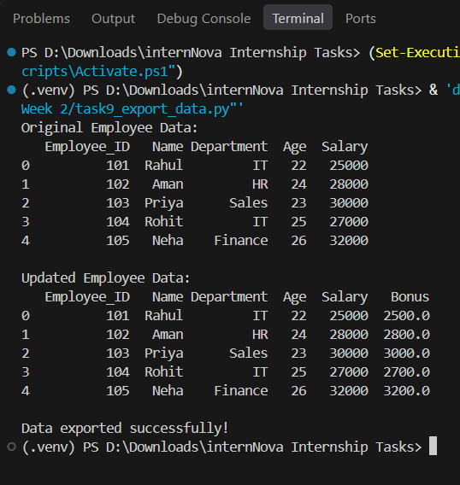
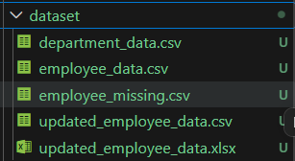
Task 9: Exporting Data (5 Marks) After processing the dataset: Export the final DataFrame to a new CSV file. Verify that the exported file contains the processed data. Save the file properly for submission.
Program
Output

Slide 10
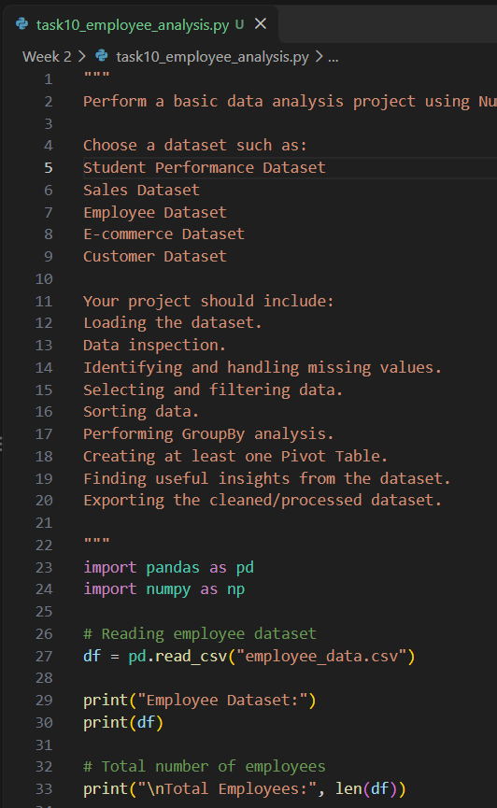
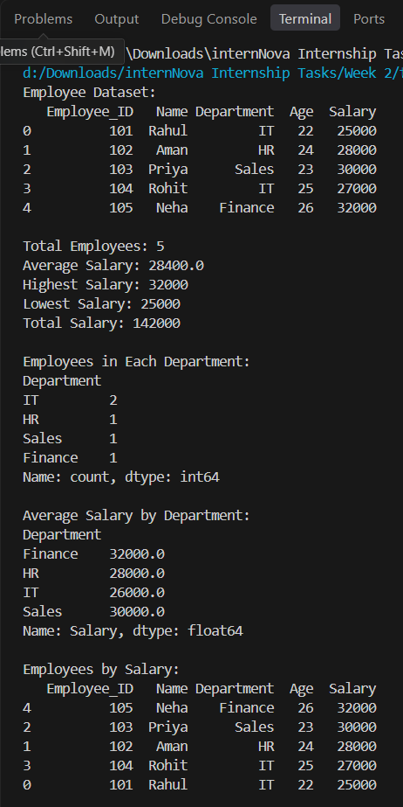
Task 10: Mini Data Analysis Project (10 Marks) Perform a basic data analysis project using NumPy and Pandas. Choose a dataset such as: Student Performance Dataset Sales Dataset Employee Dataset E-commerce Dataset Customer Dataset Your project should include: Loading the dataset. Data inspection. Identifying and handling missing values. Selecting and filtering data. Sorting data. Performing GroupBy analysis. Creating at least one Pivot Table. Finding useful insights from the dataset. Exporting the cleaned/processed dataset.
Program
Output

